Slide 1

Chatty Cart: Revolutionizing E-Commerce
AI-Driven Personalized Assistance for Customers and Product Owners

Slide 2
Introduction
Chatty Cart aims to transform the e-commerce landscape by addressing prevalent challenges through AI-driven solutions that enhance customer experience and operational efficiency.

Slide 3

Table of contents
Challenges in E-Commerce
The Role of AI in Chatty Cart
Data-Driven Pricing Strategy
Conversational AI Using Chatbot
Web Application with Streamlit

Slide 4
Challenges in
E-Commerce
High Cart Abandonment Rates Customer Dissatisfaction Inefficient Service Difficulty in Pricing

Slide 5
The Role of AI in Chatty Cart
Enhancing efficiency in e-commerce. Enabling personalized product dynamic pricing strategies. Providing real-time customer support via conversational AI. Creating an engaging shopping experience leading to increased sales and loyalty.

Slide 6
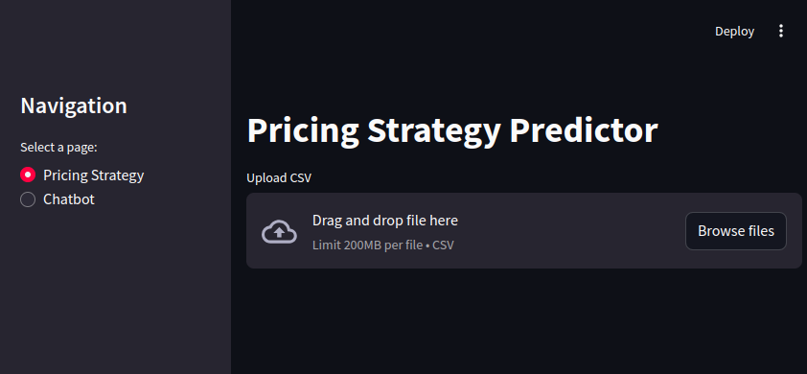
Data-Driven Pricing Strategy
Outputs of pricing strategy predictor include: Price Prediction: Recommended price based on market conditions. Market Condition Prediction: Classification of current market conditions. Price Elasticity: Score reflecting sensitivity of demand to price changes.

Slide 7
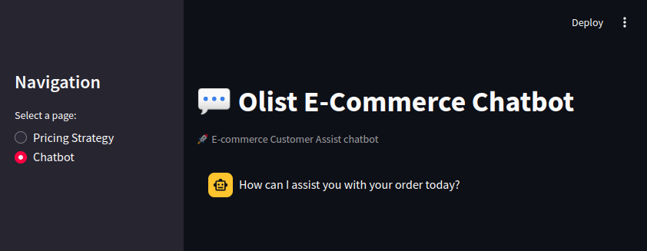
Conversational AI Using Chatbot
Chatty Cart automates processes like customer inquiries, order tracking, and recommendations. Reduces operational costs and enhances response times. Ensures timely customer assistance crucial for maintaining satisfaction.

Slide 8
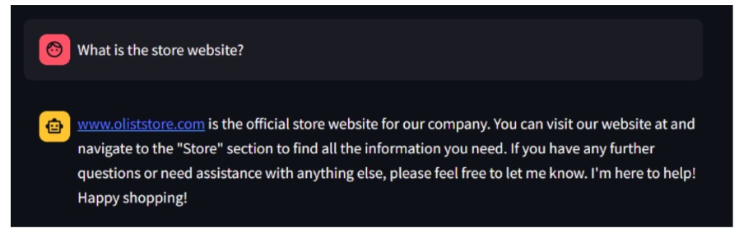
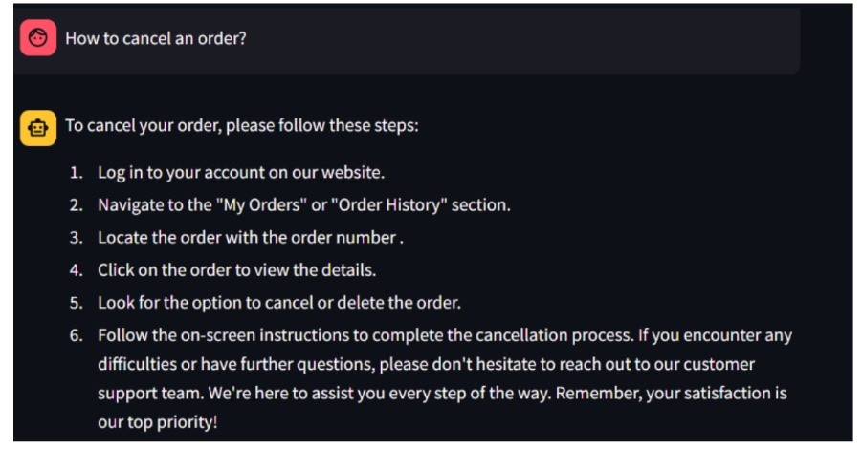
Customer Assistant Chatbot

Slide 9
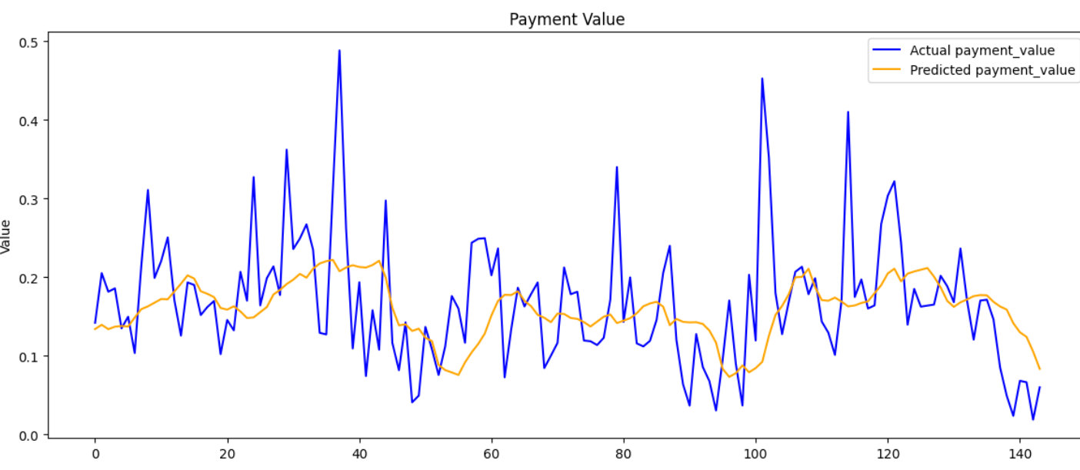
Time Series Forecasting
time series forecasting model developed to predict daily metrics related to an e-commerce dataset, specifically focusing on daily orders, payment values, and average prices.

Slide 10

Web Application with Streamlit
Streamlit serves as the user-friendly interface. Connects end-users with AI models for chatbot interactions and pricing predictions.

Slide 11
Conclusion
Chatty Cart represents a significant advancement in e-commerce, leveraging AI for personalized support and pricing strategies that enhance customer satisfaction and drive sales.

Slide 12
Thank you!

